Slide 1

Costing Activities in a
Blood Transfusion Service
WHO/QMT 9.4

Slide 2
Teaching Aim
To highlight the importance of costing all BTS activities

Slide 3
Core Topics
Definition of costing
Benefits of costing
WHO manual “Costing Blood Transfusion Services”
Basic cost analysis of BTS activities

Slide 4
Definition of Costing
Estimating the value of resources used to produce a desired product or service

Slide 5
Benefits of Costing
Provides accurate costs for budget planning
Enables realistic planning for sustainability, improvement and expansion
Enables evaluation of productivity and cost-effectiveness
Improves resource mobilization
Assists in establishing a clear identity for the financial and administrative structure of the BTS

Slide 6
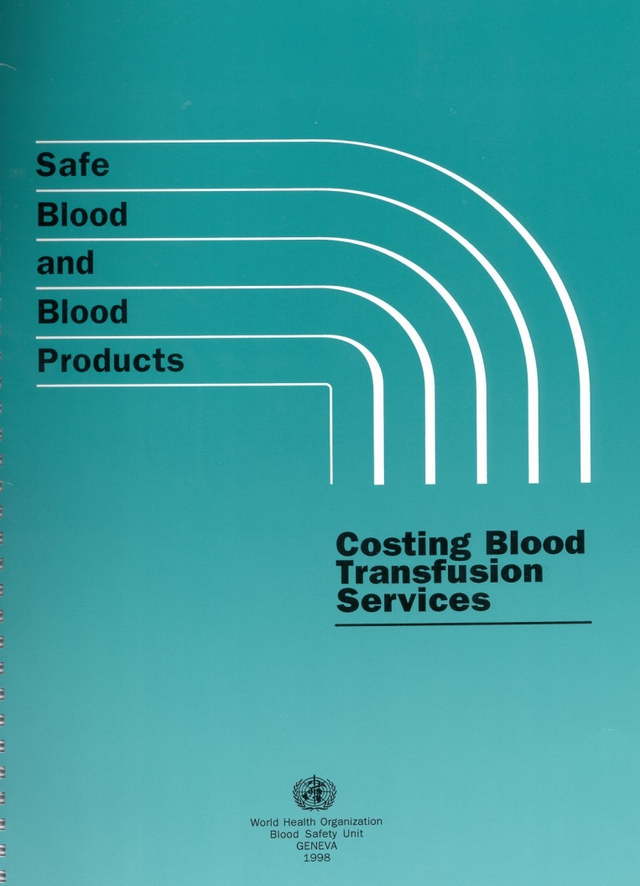
WHO Manual:
Costing Blood Transfusion Services
A WHO manual to assist
BTSs in:
Planning
Mobilizing resources
Ultimate goal – an adequate,
sustainable supply of safe
blood

Slide 7
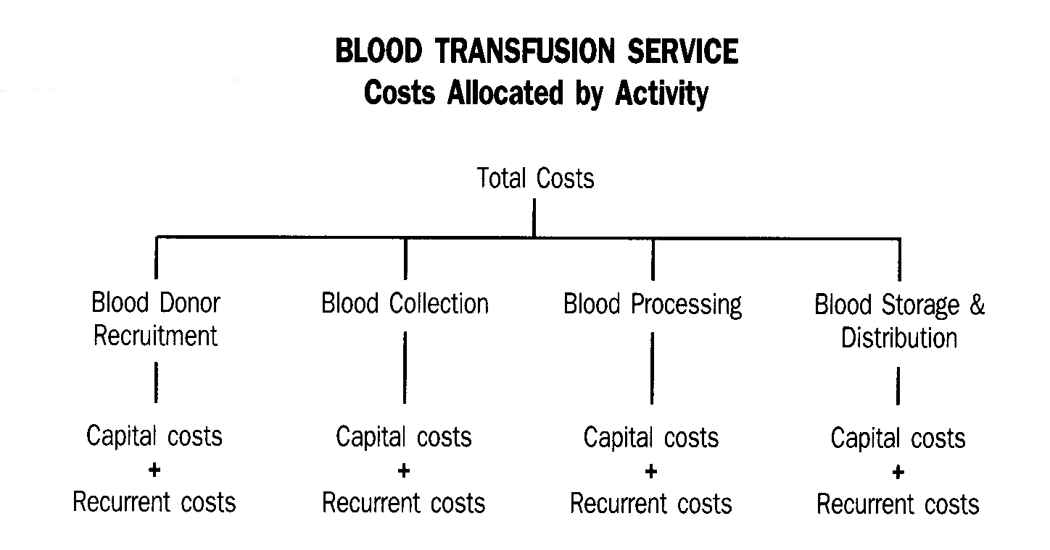
Allocation of Costs by Activity

Slide 8
Costing
Classify costs of personnel, capital and recurrent needs
Sub-divide the costs into distinct activities
  Recruitment
  Collection
  Processing
  Storage and distribution

Slide 9
Example of Classification
CAPITAL COST WORK SHEET
COSTS ALLOCATED BY ACTIVITY
%
CATEGORY / ITEM
RECRUITMENT
COLLECTION
PROCESSING
STORE & DISTR.
Total
Check
Amount
%
Amount
%
Amount
%
Amount
%
Building
Purchase/Construction
Rent
Renovation
Other/Unspecified
TOTAL Building
0.00
0.00
0.00
0.00
Vehicles
Motor vehicles
Trailers
Motor cycles
Bicycles

Slide 10
Personnel Costs
Medical director
Administrative and general staff
Donor recruitment staff
Clinic staff
Laboratory staff
Quality staff
Others: e.g. volunteers

Slide 11
Capital Costs
One-time investment costs generally incurred
during Year 1 of operation or during expansion: e.g.
Purchase, construction or renovation of BTS building
Purchase of vehicles
Purchase and installation of equipment
Purchase of furniture
Other fixed assets

Slide 12
Recurrent Costs
Operational costs that are incurred in the course
of one year, usually on a regular basis: e.g.
Personnel costs
Vehicle running costs
Utilities: e.g. electricity, water, telephone
Office, clinic, laboratory and other supplies
Equipment maintenance, repair and spare parts
Training

Slide 13
Methodology
Calculate total BTS costs using:
Computerized worksheets (Excel spreadsheet)
or
Manual worksheets

Slide 14
Calculation of Total Costs
Costs can be calculated for:
An activity: e.g. recruitment, collection, processing:
Capital + recurrent costs = Total cost per activity
Sum of all “costs per activity” = Total BTS costs
A useable unit of blood
= Total BTS costs/Number of units distributed

Slide 15
Other Factors Affecting BTS Costs
Other factors that affect total BTS costs: e.g.
Number of donors screened
Number of donors accepted
Number of donors bled
Number of useful units collected
Number of units processed, by product
Number of discards, by product
Number of units distributed by product

Slide 16
Key Points
The quality manager needs to understand the principles of costing
Accurate costing of BTS activities enables accurate budget planning and resource mobilization
Sustainability of the BTS is not achievable without costing procedures
Costing BTS activities contributes to quality monitoring

Slide 17
Learning Outcomes
You should now be able to:
Explain the value of comprehensive costing of all BTS activities
Define key factors that need to be taken into account in costing the activities of a BTS

Slide 18


Slide 19
Principles of Stock Control
WHO/QMT 9.5

Slide 20
Teaching Aim
To highlight the importance of stock control and correct storage conditions

Slide 21
Core Topics
Stock control and ordering
Perishable and non-perishable materials
Delivery checks
Quarantine of materials
Inspection of incoming materials
Correct storage of perishable materials
Monitoring correct storage conditions
Documentation

Slide 22
Stock Control (1)
Good stock control ensures that items are always available in the right quantity at the right time
Critical stock items are all items that directly or indirectly affect the ability to collect, test, process and distribute blood and blood products
Critical stock items must meet quality requirements

Slide 23
Stock Control (2)
The use of poor quality items may result in a poor quality end product or service
Designate an individual with responsibility and authority for
  Ordering stock from approved suppliers (with advice from users)
  Inspecting incoming materials
  Storing the stock at appropriate conditions
  Monitoring stock levels (usage)
  Re-ordering when necessary
Notes:
5

Slide 24
Stock Control (3)
Ensure sufficient quantities of stock by ordering in time
  Problems when delivery times cannot be guaranteed
Reliable source of supply
Plan ahead
Ordering stock

Slide 25
Stock Control (4)
Accurate records of deliveries, stock and usage
Rotation of stock - perishable/non-perishable
Contingency plans needed
  Lack of stock
  Loss of stock
  Loss of appropriate storage conditions

Slide 26
Stock Records
Monitor trends in usage
Monitor delivery schedules and reliability of each supplier
Identify items with little usage and help to rationalize items used and held in stock
Ensure accountability for all items ordered
Enable regular stock checks
Notes:
8

Slide 27
Ordering Supplies (1)
Who is responsible for ordering supplies?
  External to BTS (e.g. central government)
  BTS
    Central purchasing department
    Technical department

Slide 28
Ordering Supplies (2)
Determine an appropriate stock level
  User needs
  Storage space
  Cost
  Specific ordering strategies: bulk, standing order, as required
    WHO bulk procurement scheme: HIV test kits
  Delivery time
  Quarantine period

Slide 29
Delivery Checks
All material should be checked on delivery
The checks should ensure
  Conformity with order
  Quality specifications are met
Follow quarantine/release procedure

Slide 30
Quarantine of Materials (1)
Quarantine materials until incoming tests have been performed and the materials have passed
  Depends on materials
  Depends on type of checks performed
  May involve quality department in performing checks and authorizing release

Slide 31
Quarantine of Materials (2)
Physical labelling and segregation
  Clear labels indicating that materials not yet checked
  Locked storage areas
Release of suitable materials to active stock
  Clear labels indicating that materials have passed required checks

Slide 32
Inspection of Incoming Materials
Inspection depends on the supplier
  Regular supplier
  Audited supplier
  Goods of a nature that a supplier statement may be sufficient
Inspection specifications needed for all items

Slide 33
Perishable/Non-Perishable Materials (1)
Need to distinguish between materials that are perishable and those that are not
  Perishables include reagents, blood bags
  Non-perishables include plastics, collection tubes, equipment

Slide 34
Perishable/Non-Perishable Materials (2)
Perishables have stricter storage conditions and expiry dates and require significant release testing
  Controlled storage conditions
  Stock rotation (first in first out “FIFO”)
  Quarantine areas

Slide 35
Storage of Perishables
Storage conditions
  Correct temperature (and humidity)
  Sufficient space
  Security with appropriate accessibility
  Protected from infestation
  Protected from bacterial/fungal contamination
Stock rotation
  Expiry dates
  Usage rates

Slide 36
Monitoring of Storage Conditions (1)
Regular/continuous monitoring of storage conditions
  Temperature
  Signs of infestation
  Signs of dampness
Access to storage area
  Staff allowed in the area
  Unauthorized access

Slide 37
Monitoring of Storage Conditions (2)
Quarantine integrity
  Quarantine materials labelled and separated adequately
  Formal release of materials from quarantine

Slide 38
Documentation (1)
Records (manual or electronic)
  Clear description of item
  Supplier’s generic/trade name and product code
  In-house product code
  Expiry date
  Delivery date and quantity
  Unit quantity

Slide 39
Documentation (2)
Records (manual or electronic)
  Supplier’s name and contact person
  Lead time for supply
  Normal internal users of the item
  Desirable stock figure
  Re-order point and normal re-order quantity

Slide 40
Documentation (3)
Documented procedures for stock control, including:
  List of approved suppliers and their products
  Ordering of goods
  Receipt of goods
  Quarantine and release procedures
  Record keeping
  Stock control
  Stock checks
  Training records

Slide 41
Key Points (1)
All BTSs need a good stock management system
Sufficient stocks of critical items must be maintained at all times
All incoming materials must be appropriately checked before use

Slide 42
Key Points (2)
Quarantine and release procedures must be in place for certain items
Monitoring of usage can help ensure adequate stock levels are maintained

Slide 43
Learning Outcomes
You should now be able to:
Describe methods of monitoring the stock control system
Identify the factors that can influence storage conditions
Explain the principles of quarantine/release procedures
List essential documentation and records for stock control

Slide 45
Quality Aspects of
Contingency Planning
WHO/QMT 9.6

Slide 46
Teaching Aim
To encourage the development of contingency plans to ensure an adequate supply of safe blood products at all times

Slide 47
Core Topics
Maintaining the safety and adequacy of the blood supply
Plans and procedures
Major disasters or incidents
Responsibility: role of the quality manager
Planning to minimize adverse outcomes
Co-ordination with other agencies

Slide 48
Adequacy
Adequacy is an important quality element
Adequate supplies of safe blood and blood products should be available to meet any situation
Adequacy of the blood supply depends on many other elements: e.g.
  Good planning
  Adequate number of suitable blood donors
  Availability of blood bags, reagents and test kits
  Adequate number of trained staff

Slide 49
Incidents and Disasters
Potential threats to adequacy of blood supply
Major incidents and disasters
    Man-made
    Natural
Localized incidents
    Power failure
    Equipment failure
    Supply failure

Slide 50
Examples of Incidents (1)
Loss of a donor session venue with no local alternative
Session venue cannot be used when team arrives
Temporary sudden loss of donors due to outbreaks of disease
Sudden significant increased demand: e.g. major train crash involving many people

Slide 51
Examples of Incidents (2)
Supply problems
  No blood bags left in stock, nothing available in country for 1-2 weeks
  Shortage of test kits or reagents due to delivery problems
Breakdown of cold storage equipment
Mobile team vehicle breaks down on way to session

Slide 52
Plan
Those who fail to plan,
plan to fail

Slide 53
Responsibility and Planning
The quality manager is responsible for ensuring:
Appropriate contingency plans at each local centre are prepared, available and reviewed
Each local centre has a disaster planning team which is responsible for the development and management of the plans
  Specific plans (clearly definable incidents)
  Generic plans (to cover a wide range of similar issues)

Slide 54
Disaster Planning Team
A team of senior staff from the different areas of the BTS
Represent all the main BTS activities
May be led by the quality manager
Can look at all potential problems and how to respond to them
Have the authority to put plans in place

Slide 55
Planning (1)
Documented plans should be in place to deal with any incident that threatens the adequacy or safety of the blood supply
Identify the possible incidents and resultant threats to product quality/patient safety

Slide 56
Planning (2)
Identify
What needs to be done to prevent/minimize adverse outcomes
How to do it
Who is responsible for ensuring that it is done
Who needs to be directly involved
Who needs to know

Slide 57
Planning a Response (1)
Define different levels of solutions
  Resolvable internally/externally
  Resolvable quickly/longer period
  Resolvable by simple response/complex changes
  No loss/minimal loss/acceptable loss/significant loss
Plan what needs to be done until the situation is resolved

Slide 58
Planning a Response (2)
Define different actions to minimize adverse outcomes
  Obtain blood from another blood centre
  Repair immediately
  Borrow stock from another laboratory/hospital/BTS
  Delay testing until stock arrives
  Transfer workload to another site
Plan how to handle the possibility of a sudden increase in donor numbers in response to a disaster

Slide 59
Living with the Possibilities
An incident could happen at any time
Policies and plans need to be in place
These need to be available to all staff
All staff need to know what to do and when
Policies and plans need to be reviewed regularly

Slide 60
Coordination with Other Agencies
BTS disaster plans need to be included in appropriate national plans
Plans at the local blood centre should be included in plans of local emergency services
BTS needs to be actively involved in planning response to disasters/emergencies where
  Blood or blood products may be needed
  The public may THINK that blood may be needed

Slide 61
Key Points (1)
Things do go wrong
Disasters do happen
The continuity of a safe blood supply is essential
Contingency planning is essential

Slide 62
Key Points (2)
Documented procedures need to be in place, available to all staff and reviewed at appropriate intervals
BTS plans need to be incorporated into appropriate national and local contingency plans

Slide 63
Learning Outcomes
You should now be able to:
Identify situations that may threaten the safety and adequacy of the blood supply
Develop a contingency plan for the BTS

